Slide 1


Bank-Customer Relationship Management
SQL Project

Slide 2


Objective
Enhancing Customer Loyalty: Bank Customer Relationship Management Strategies
Understanding customer loyalty is crucial for bank success. Effective CRM strategies can help build long-term relationships with customers, leading to increased retention and satisfaction.

Slide 3
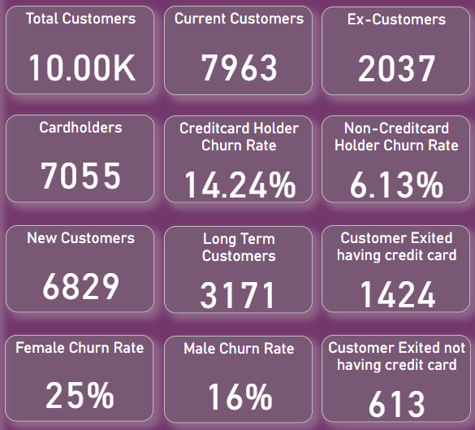
Data-driven Insights
01
Customer Segmentation:
02
Churn Analysis:
03
Geographic Differences:
04
Growth Trends:
05
Potential Areas for Improvement:
06
Conclusion

Slide 4
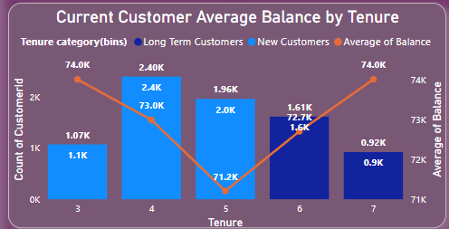
Customer Segmentation:
Tenure: There are two main customer segments based on tenure: new (3-5 years), long-term (6-7 years), and ex-customers. Long-term customers tend to have higher average balances, suggesting increased spending over time.
The key insight from this graph is that long-term customers tend to have higher average balances compared to new customers across all tenure periods shown.

Slide 5
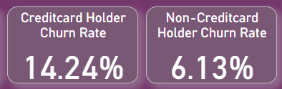
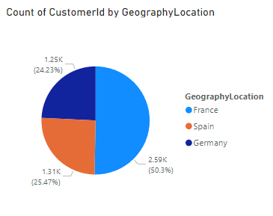
Credit Card Holders: Credit card churn is significantly higher (14.24%) compared to non-cardholders (6.13%). This suggests a potential need to improve the credit card user experience or benefits.
Activity: 63.92% of customers are active, with France having the highest number .

Slide 6
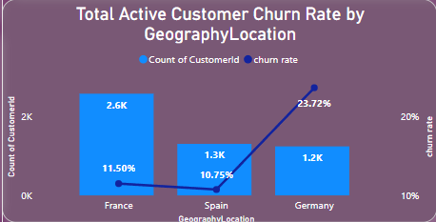
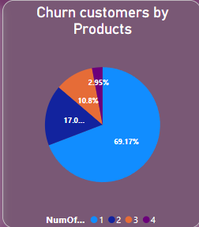
Churn Analysis:
Overall Churn: The overall churn rate is 20.37%.In case of active customers Germany has the highest churn (23.72%), followed by France (11.50%) and Spain (10.75%).
Product Usage: 69.17% of exiting customers only used one product, suggesting a need to improve cross-selling or product bundling strategies.

Slide 7
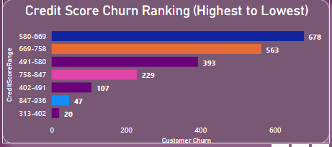
Credit Score: Customers with credit scores between 580-669 are more likely to churn. Tailoring marketing efforts or special offers to this segment could be beneficial.

Slide 8
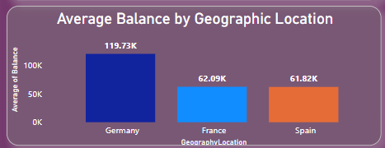
Geographic Differences:
Average Balance: Germany has the highest average balance (119.73k) across the three regions (Germany, France, Spain).

Slide 9
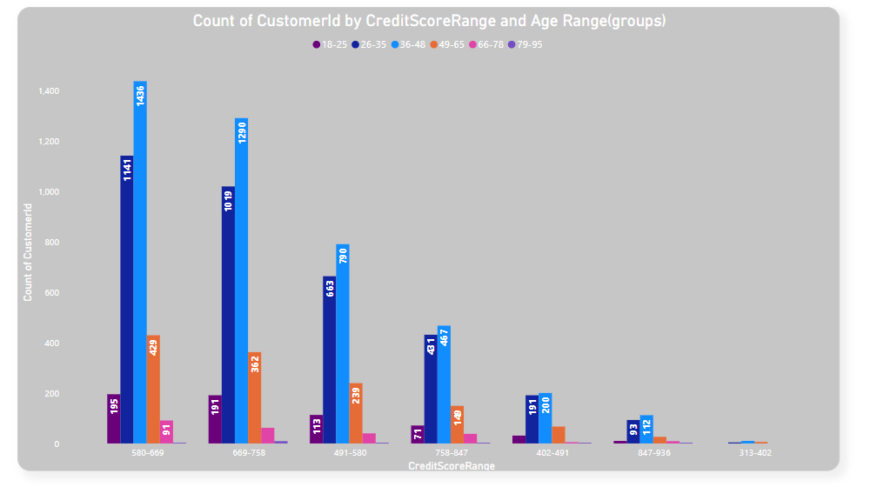
The number of customers with a credit score in the range of 580-669 is particularly high across all age groups. This might be a credit score range that many people achieve over time, or it could be a target range for many lenders.

Slide 10
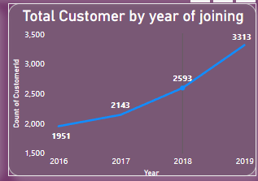
Growth Trends:
Customer acquisition seems to be increasing year-over-year.

Slide 11

Potential Areas for Improvement:
Reduce Churn: Investigate reasons behind high churn rates in France and Germany. Focus on retaining existing customers, especially credit card holders and high-potential segments like those with lower credit scores.
Increase Product Usage: Encourage multi-product usage through targeted marketing or bundling strategies.
Improve Customer Experience: Analyze why customers with only one product churn at a higher rate. Investigate and address any pain points related to specific products or services.

Slide 12


Conclusion
In conclusion, the CRM bank churn has provided invaluable insights into the dynamics of customer attrition and has equipped us with actionable strategies to effectively control churn rates. Through meticulous data analysis and observation, several key takeaways have emerged:
1.Identification of Churn Patterns: By examining demographic segments and financial metrics, we've identified patterns indicating which customer groups are most prone to churn. This understanding forms the basis for targeted interventions.
Detection of Churn Trends: Over the years, there has been a discernible increase in churn rates, particularly since 2017. This trend signals a pressing need for proactive measures to counteract the potential financial risks associated with escalating customer attrition

Slide 13


To control churn rates effectively, we propose a multifaceted approach:
•Personalized Retention Strategies: Develop tailored retention initiatives that cater to the unique needs and preferences of different customer segments. By offering personalized incentives, enhanced services, and customized product offerings, we can bolster customer loyalty and reduce churn.
•Financial Health Promotion: Implement programs aimed at improving the financial well-being of customers. This could involve providing financial education resources, offering debt management assistance, and facilitating access to financial planning tools. Strengthening customers' financial stability is pivotal in mitigating churn risk.

Slide 14

•Proactive Engagement: Deploy early warning systems and predictive analytics to identify at-risk customers before they reach the point of churn. Proactive outreach efforts, such as targeted marketing campaigns and proactive customer service interventions, can help preemptively address concerns and retain valuable clientele.
Continuous Optimization: Establish a framework for ongoing monitoring and analysis to assess the effectiveness of retention strategies and adapt them as needed. Regularly review customer feedback, market trends, and internal performance metrics to refine our approach and stay ahead of evolving churn dynamics

Slide 15
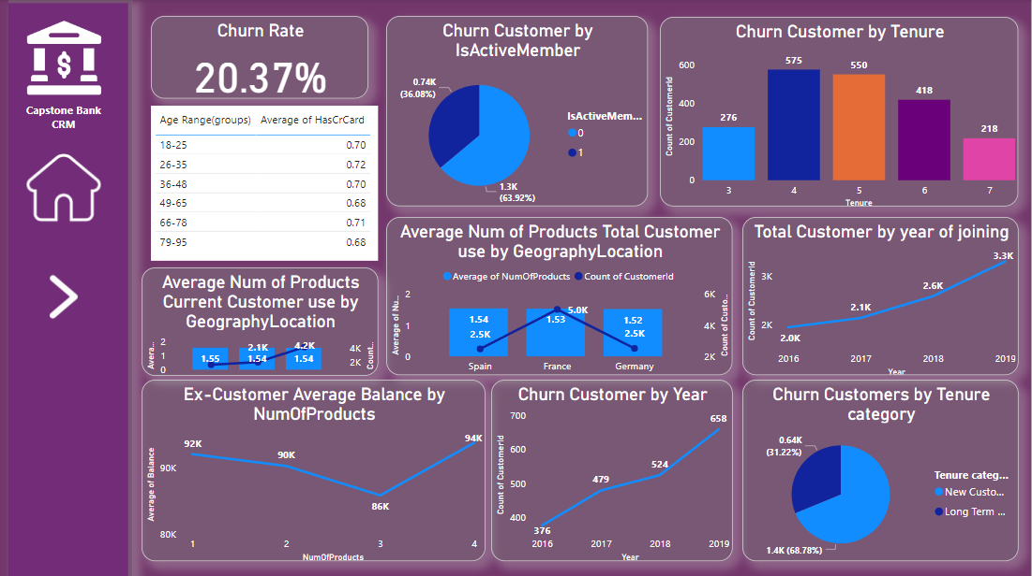
Dashboard

Slide 16
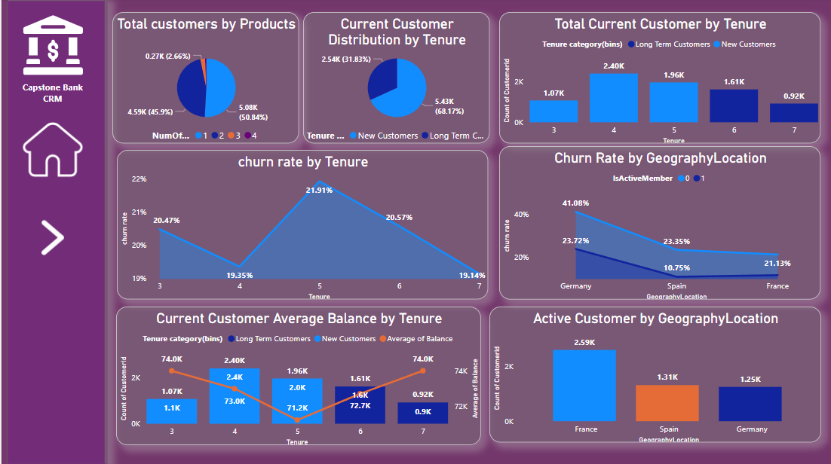

Slide 17
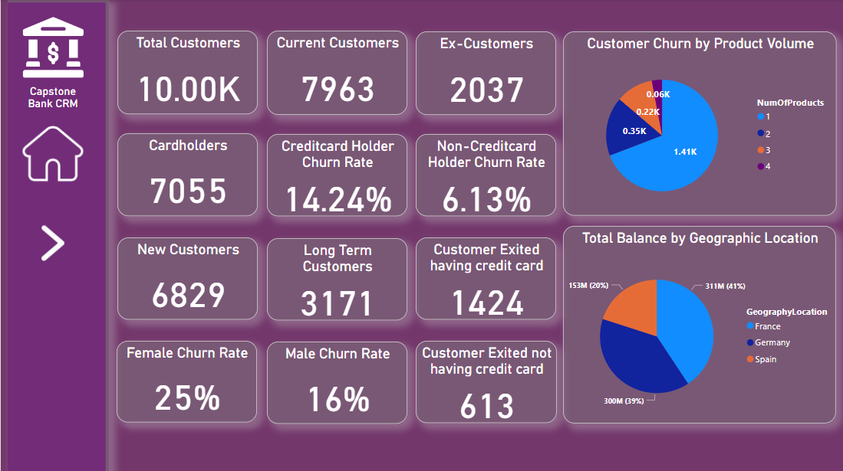

Slide 18
Thankyou

